Slide 1

Driving Data Insights:
Scraping Tata Cars in Mumbai

Slide 2

Team Leads
Vaibhavi
Nandita
Akshar
Lead
Co-Lead
Co-Lead

Slide 3
Extended Team Members
Aachal Gupta
Aarjav Jain
Pabitra Goswami
Saili Ashok Dhuri
Pratham Jindal
Shubham Arvind Rangari
Abeed Mohammed
Ketan Kumar Sendre

Slide 4

Extended Team Members
Alfed Khan
Juweriya shayhmeen
Dayal kumar sarkar
Ashmit Zanzote
Kunal Kumbhar
Sudarshan Sopane

Slide 5
Content
1
2
3
4
5
Introduction and
Objectives
Data collection and web scraping
Data processing and
Cleaning
Data analysis and
Insights
Challenges
and
Conclusion

Slide 6
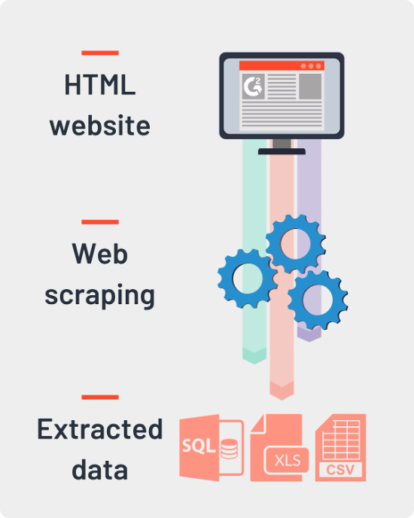
Objectives
Our objectives are to collect and scrape detailed data on Tata cars listed for sale in Mumbai from Cars24.com, ensuring data accuracy through cleaning and processing and providing valuable information for potential buyers and sellers.

Slide 7
Data Collection
Website Used
Data was extracted from Cars24.com, a prominent platform for used car listings.
Key Data Points
Focused on extracting car model, price, year of manufacture, mileage, fuel type, transmission, and location.
Python Libraries Utilized
Employed Beautiful Soup for parsing HTML and Selenium for handling dynamic content.
Automated Scraping Process
Developed Python scripts to automate the data extraction process, ensuring efficiency and thoroughness.
Data Accuracy
Implemented measures to verify the accuracy and completeness of the scraped data, enhancing dataset reliability

Slide 8
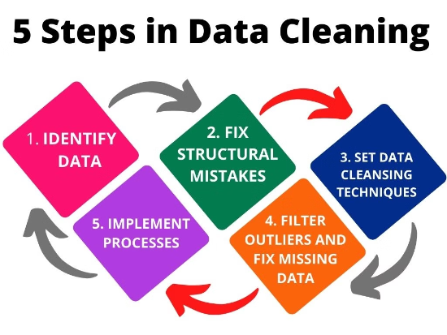
Data Cleaning
We used data cleaning to enhance our dataset by removing duplicate entries, filling or excluding missing values, standardizing data formats, correcting data types, and identifying outliers. These steps ensured our data was accurate, consistent, and reliable for analysis.

Slide 9
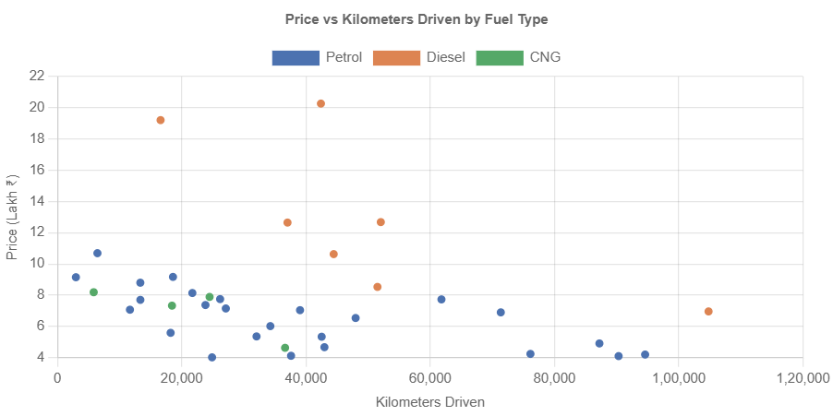
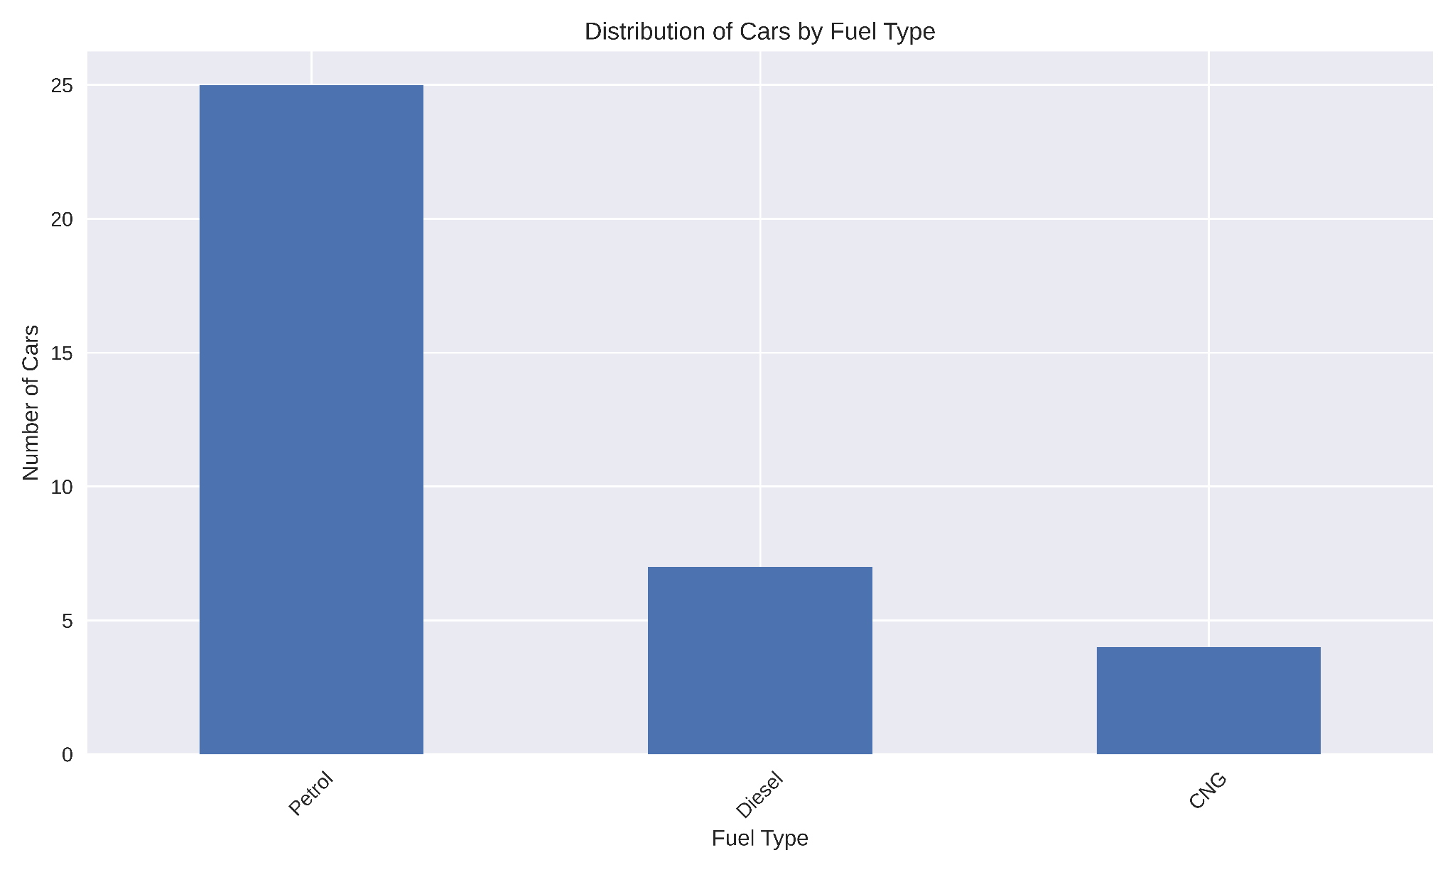
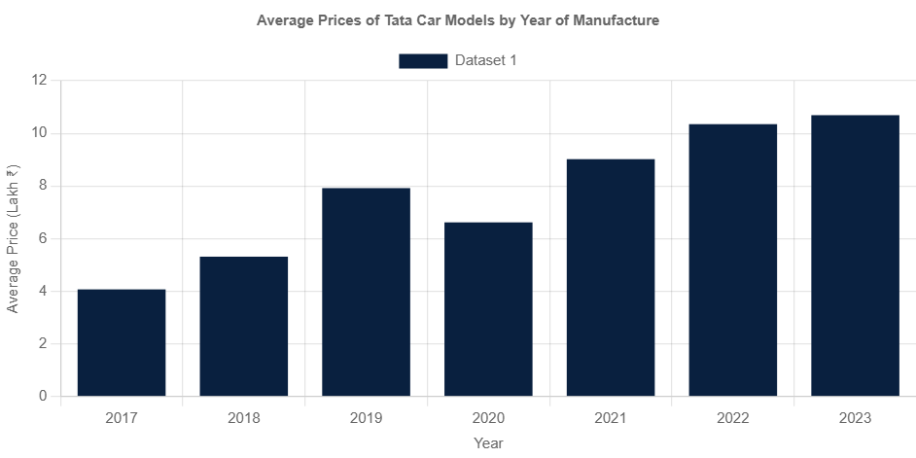
Data Analysis

Slide 10





Insights and Findings
Popular Models
Tata Tiago and Tata Tigor
Average Pricing
Manual - ₹7.34 lakhs , Automatic - ₹8.66 lakhs
Mileage Ranges
Analysis of the data shows a general trend of lower prices for cars with higher mileage
Fuel type preference
Petrol cars dominate the listings, with 25 petrol cars compared to 7 diesel cars and 4 CNG cars
Transmission Preference
The data reveals a significant preference for manual transmission cars

Slide 11
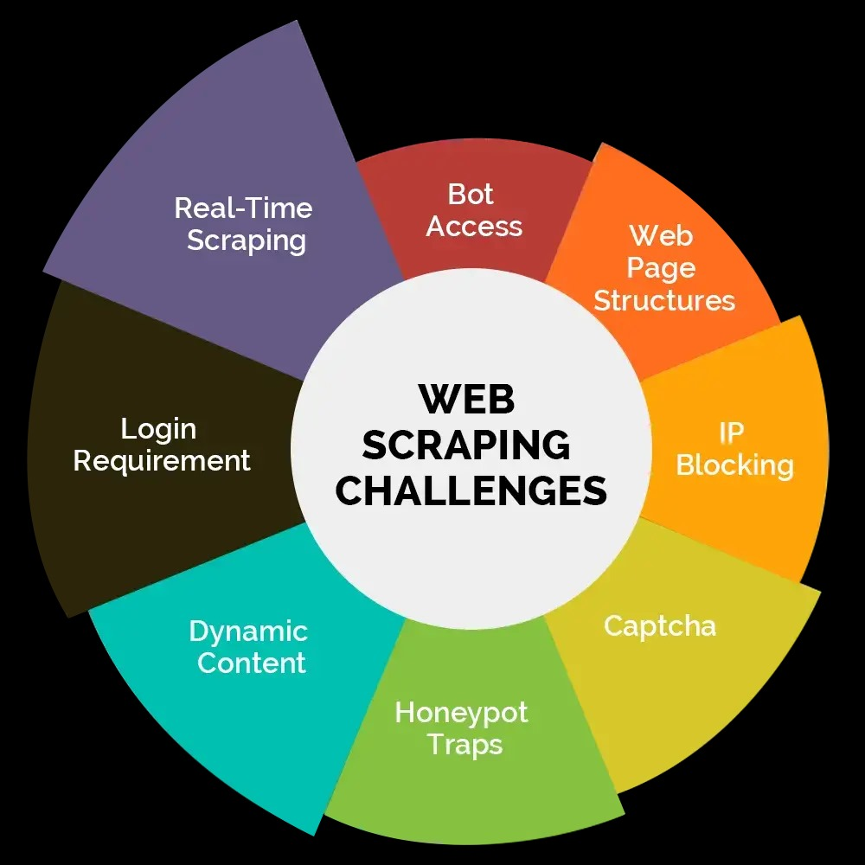
Challenges
Dynamic Web Content
Adapting scraping techniques to handle dynamic web content
Data Accuracy
Ensuring data accuracy and completeness
Missing Data
Dealing with incomplete or missing data

Slide 12
Conclusion
Successful Data Collection: Scraped detailed information on Tata cars in Mumbai from Cars24.com
using Python libraries like Beautiful Soup and Selenium.
Key Insights:
Most popular models identified.
Average pricing trends analyzed.
Mileage ranges, fuel type, and transmission preferences determined.
Challenges Overcome: Managed dynamic web content and ensured data accuracy.
Future Work: Automate scraping for real-time data updates and continuous analysis.
Value: Provides valuable insights for buyers and sellers in the Mumbai Tata car market.

Slide 13

Thank You
Thank you for your attention. We are now open to any questions or feedback you may have.

